Slide 1
Group 1
Real Estate Affordability
By: Lori Harris, Brianna McKelvey,
Rachel Powell, Joe Robbins

Slide 2
Agenda
01
Motivation & Summary
Real Estate Affordability
A
02
Questions & Data
Zillow.com, Realtor.com, Bureau of Labor Statistics, Google Maps API
03
Data Analysis & Discussion
Process, Findings, Figures, General Conclusions
04
Post Mortem
Difficulties, Additional Steps

Slide 3
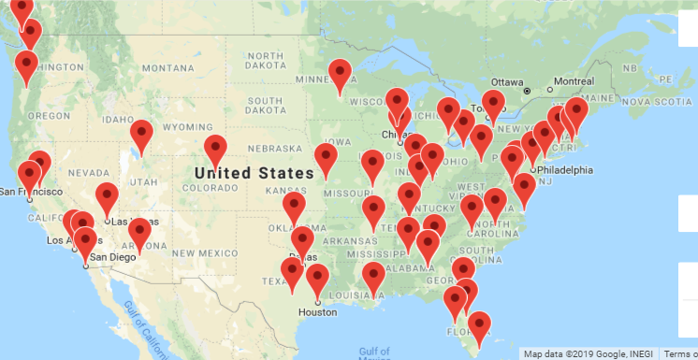
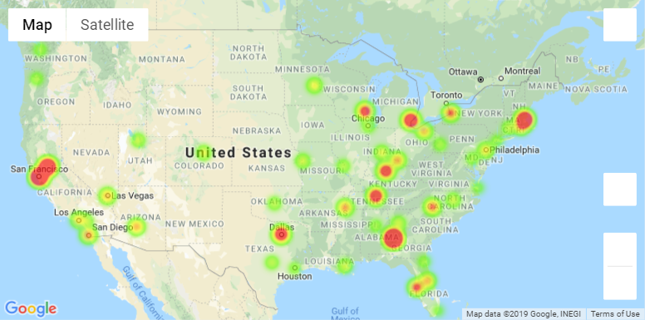
Motivation & Summary
01
How has real estate affordability for home buyers changed over time in the top 50 US cities based on population?

Slide 4
Questions & Data
02
Affordability = Household Income
Mortgage Payment
*Mortgage Payment of Median-Valued Home
30-year fixed interest rate
Monthly Median Household Income

Slide 5
Comparing Affordability
Median Income
Current City “Hotness” Score
Homebuyers
vs.
Renters
Unemployment
Rate
Education Attained

Slide 6
Data Sources
Zillow.com
Realtor.com
Provided Data on City Affordability
Gave us the “Hotness” Scores for our cities
FHFA.gov
OpenWeatherMap API
Homebuyer Demographics
City Coordinate Data
Data
Bureau of Labor Statistics
Google Maps API
Unemployment Rates
Median Income
Education Attainment Statistics
To provide some “Pretty Sweet” Images

Slide 7
03
Data Analysis &
Discussion

Slide 8
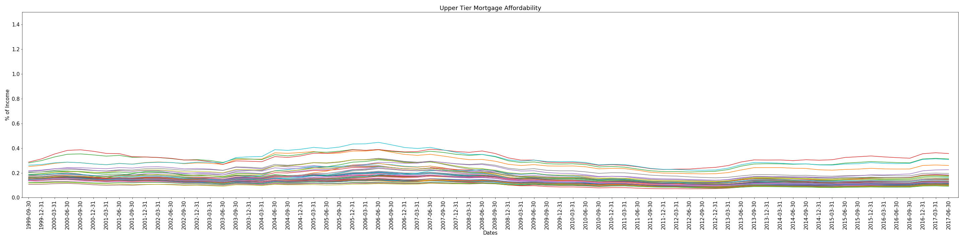
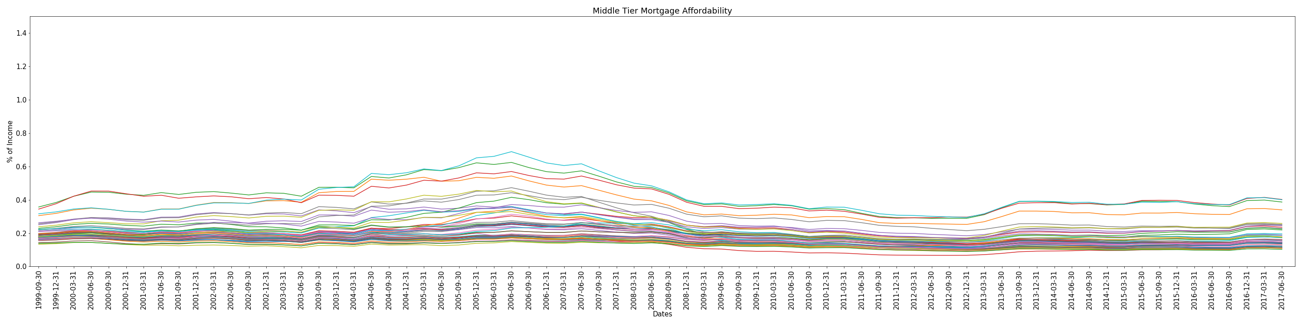
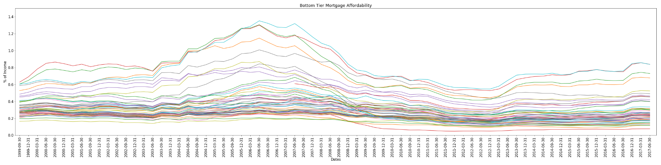
Three Tier Comparison

Slide 9
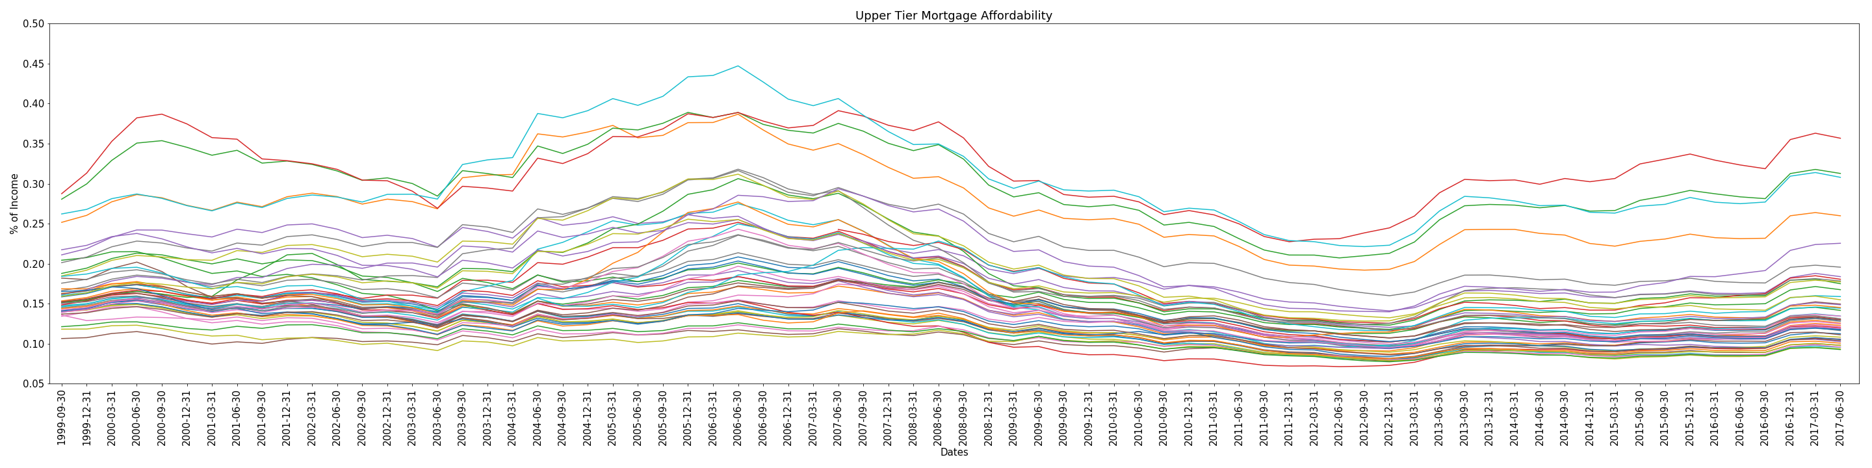
Affordability
Divided Affordability into 3 tiers based on median income
Upper Tier: >$118,000
1999:
Highest: San Jose, CA; 27%
Raleigh, NC: 15%
Lowest: Buffalo, NY; 10%
2017:
Highest: San Jose, CA; 36%
Raleigh, NC: 13%
Lowest: Pittsburgh, PA; 9%

Slide 10
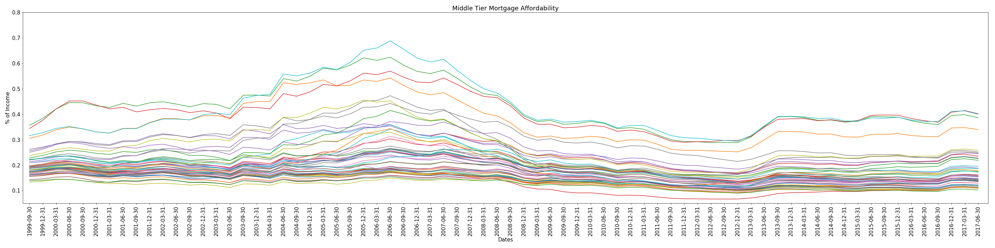
Affordability
Divided Affordability into 3 tiers based on median income
Middle Tier: $40,001 to $117,999
1999:
Highest: San Francisco, CA; 34%
Raleigh, NC: 19%
Lowest: Oklahoma City, OK; 13%
2017:
Highest: LA-Long Beach-Anaheim, CA; 40%
Raleigh, NC: 15%
Lowest: Pittsburgh, PA; 10%

Slide 11
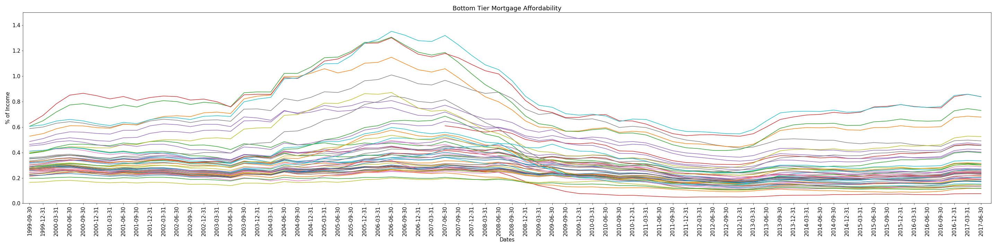
Affordability
Divided Affordability into 3 tiers based on Household median income
Bottom Tier: <$40,000
1999:
Highest: LA-Long Beach-Anaheim, CA; 59%
Raleigh, NC: 34%
Lowest: Oklahoma City, OK; 15%
2017:
Highest: LA, CA: 84%
Raleigh, NC: 24%
Lowest: Pittsburgh, PA; 9%

Slide 12
Freddie Mac and Fannie Mae Demographics
2008 |  | 2017
Income | $393,526 | Income | $110,800
Males | 2,887,904 | Males | 2,326,235
Females | 1,234,386 | Females | 1,110,531
Avg. Age | 46.0 | Average Age | 46.5
1st Time Age | 36.0 | 1st Time Age | 36.4
1st Time Income | $120,095 | 1st Time Income | $87,058
Total Mortgages | 4,683,120 | Total Mortgages | 3,705,045

Slide 13
Affordability Demographics
What does housing affordability look like for the average home owner?
Educational Attainment
02
03
Education and Income
Does Educational Attainment increase or decrease the affordability?
How do education and income work together to affect affordability?
01
04
Unemployment Rate
Average Mortgage Payer
Does the unemployment rate pay a significant role in affordability?
Pulling it all together – what do the stats of an average mortgage payer look like?

Slide 14
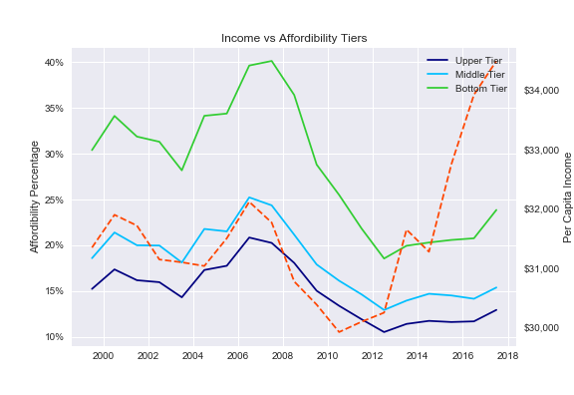
Affordability Demographics
Income
Bottom Tier spends the most
Margins remain constant
1999-2010: income and affordability closely correlate
2010-2012, income goes up, amount spent went down.
2012-2017 income rising, amount spent stagnant
2017-2018, incoming rising and affordability beginning to decrease

Slide 15
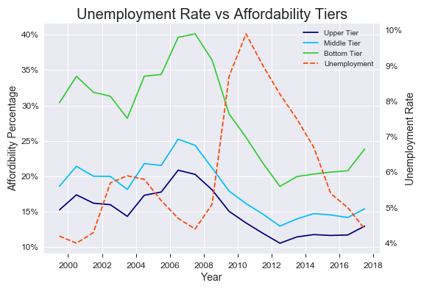
Affordability Demographics
Unemployment
When unemployment increased:
So did Affordability
Possibilities:
Government assistance
Downsizing to save
Economic Contraction

Slide 16
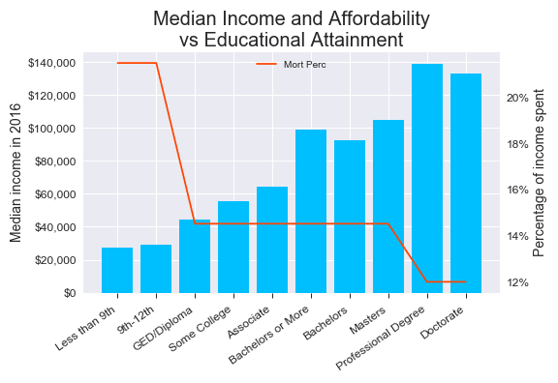
Affordability Demographics
Education
Income increases with higher education
Doctorate only 12%
Less than HS 22%
Big jump with diploma from 22% to 14%
Middle tier, is very middle:
Average income, affordability, education
As income goes down, affordability goes down

Slide 17
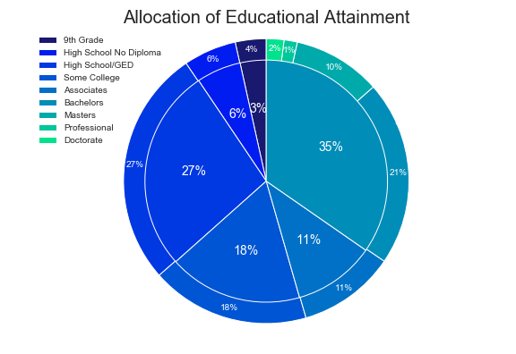
Affordability Demographics
Educational Allotments
Most mortgage payers have finish HS
Most get post-secondary education
More than a third obtain a Bachelor’s degree or Higher

Slide 18

Affordability Demographics
So Who’s Your Average Mortgage Payer in America? (2016)
Employment
Income
Tier
Education
5%
$99,160
Middle
Bachelor’s +

Slide 19





Real Estate “Hotness”
Supply
Demand

Slide 20
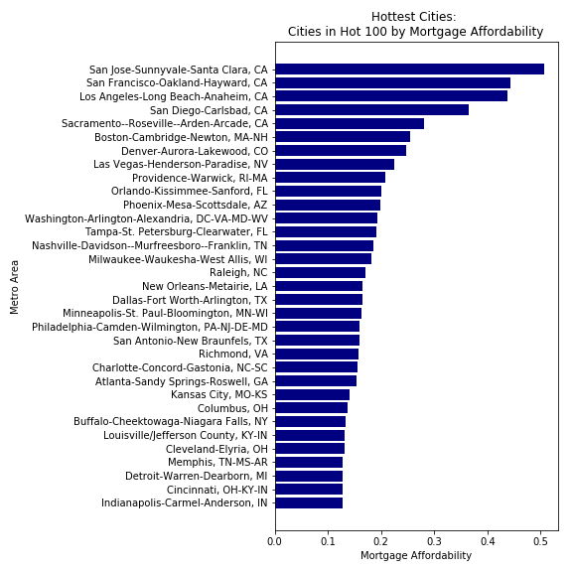
Real Estate “Hotness”
Raleigh

Slide 21
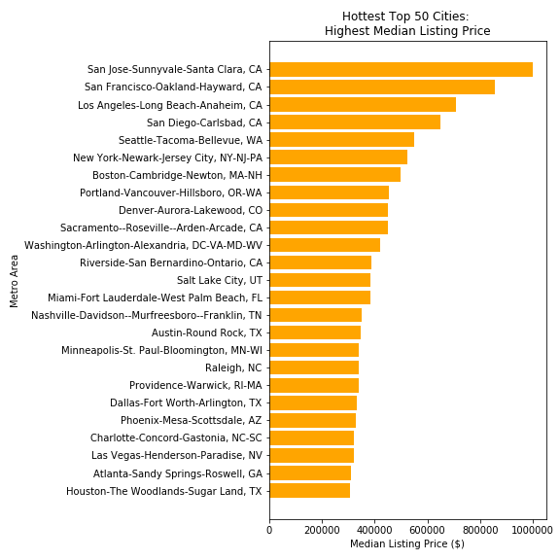
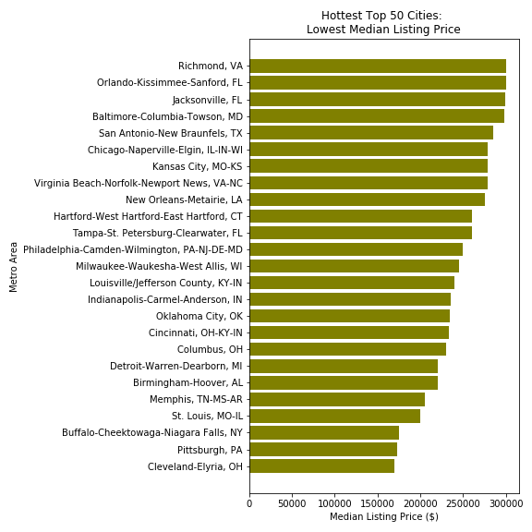
Listing Price “Hotness”
Raleigh

Slide 22
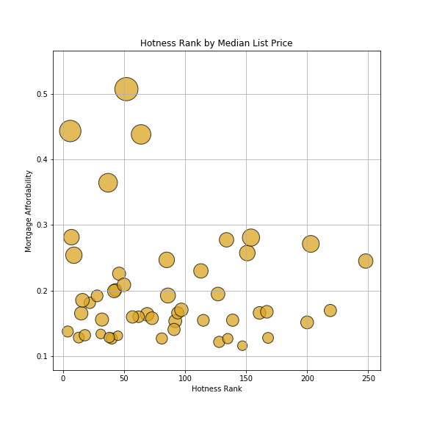
Hotness vs Affordability
Most Hot cities are affordable
Raleigh:
Hotness score: 97
Affordability: 0.1705
Raleigh

Slide 23
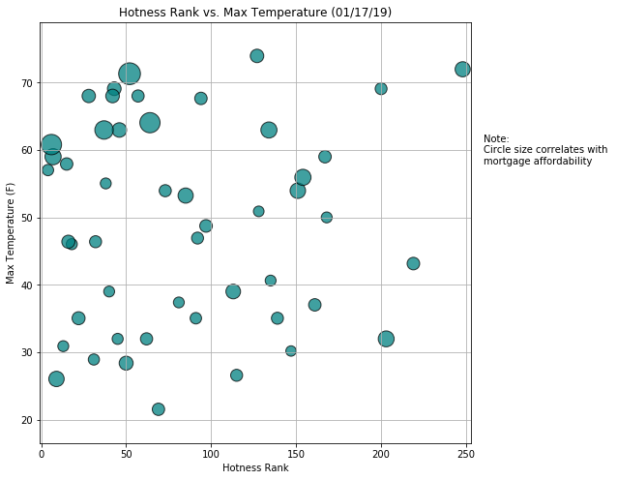
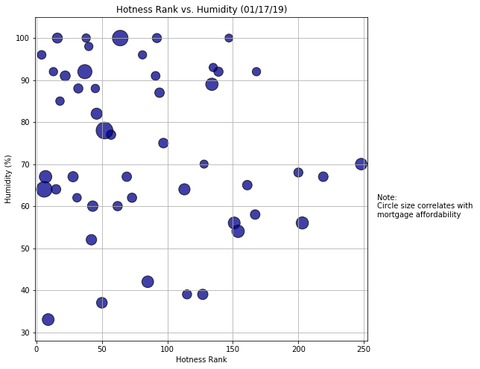
Real Estate “Hotness”
Raleigh
Raleigh
Any correlation between Hotness score and Heat (Temp)?
Not really
Mortgage affordability does
Any correlation between Hotness score and Humidity?
Maybe!
Interesting that most are > 50%

Slide 24
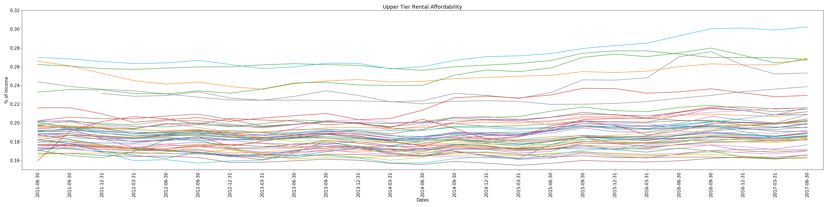
What about Renters?
Looking at the Affordability for Renters
Upper Tier: >$118,000
2011:
Highest: LA-Long Beach-Anaheim, CA; 27%
Raleigh, NC: 17%
Lowest: Kansas City, MO; 14%
2017:
Highest: LA-Long Beach Anaheim, CA; 30%
Raleigh, NC: 16.3%
Lowest: Oklahoma City, OK; 16.2%

Slide 25
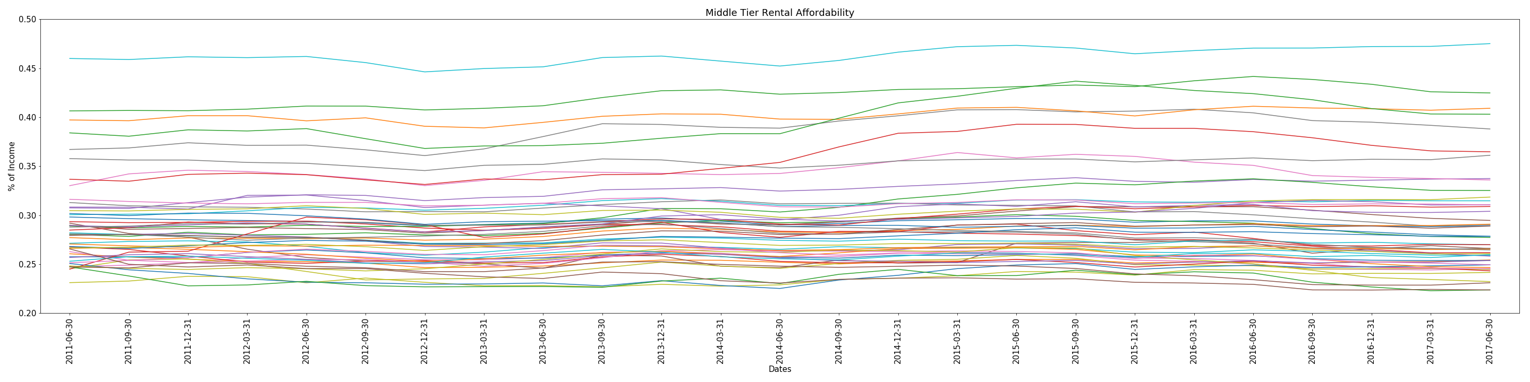
Rent Affordability
Middle Tier: $40,000 to $118,000
2011:
Highest: LA-Long Beach-Anaheim, CA; 46%
Raleigh, NC: 25%
Lowest: Cincinnati, OH; 21%
2017:
Highest: LA-Long Beach Anaheim, CA; 48%
Raleigh, NC: 23%
Lowest: Pittsburgh, PA; 22%

Slide 26
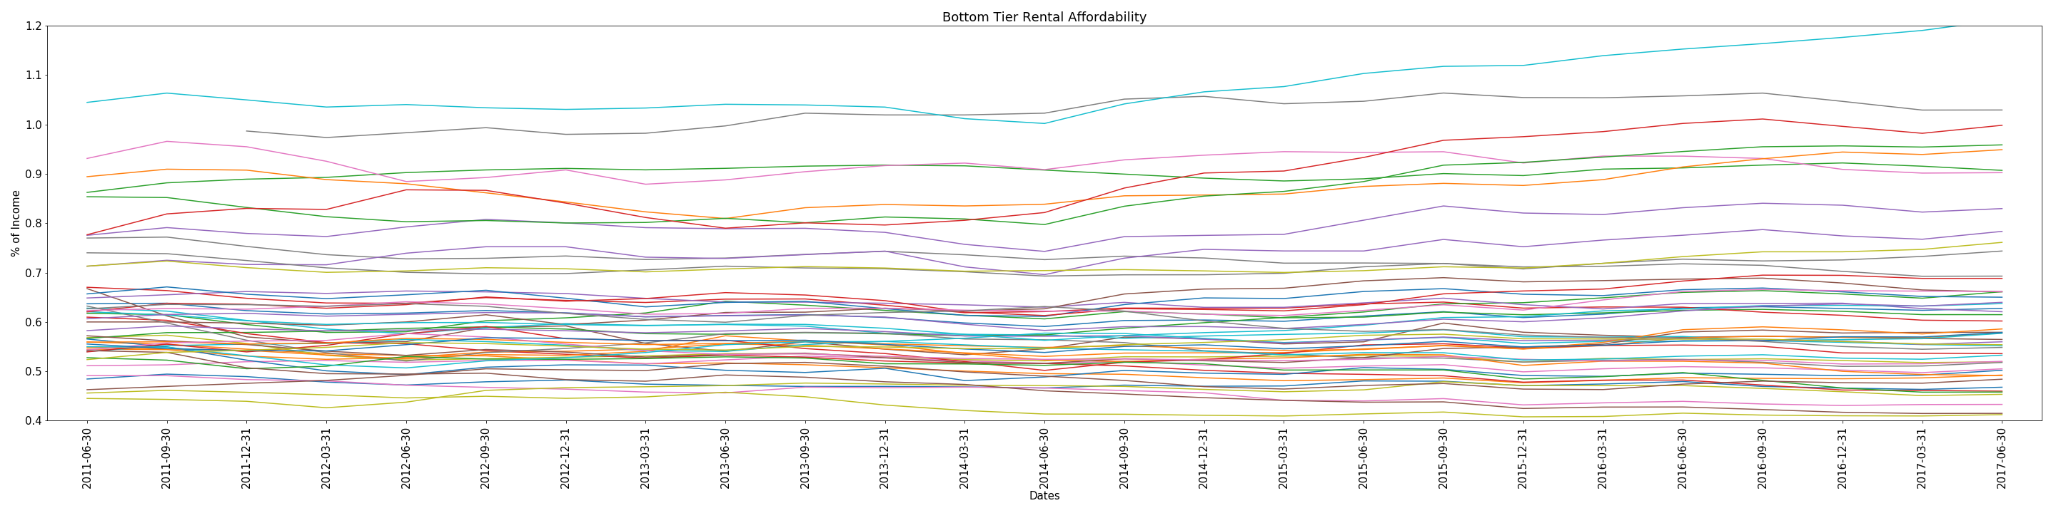
Rent Affordability
Bottom Tier: <$40,000
2011:
Highest: LA-Long Beach-Anaheim, CA; 107%
Raleigh, NC: 47%
Lowest: Kansas City, MO; 41%
2017:
Highest: LA-Long Beach Anaheim, CA; 120%
Raleigh, NC: 48%
Lowest: Kansas City, MO; 41%

Slide 27
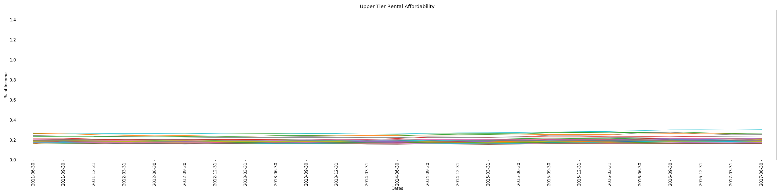
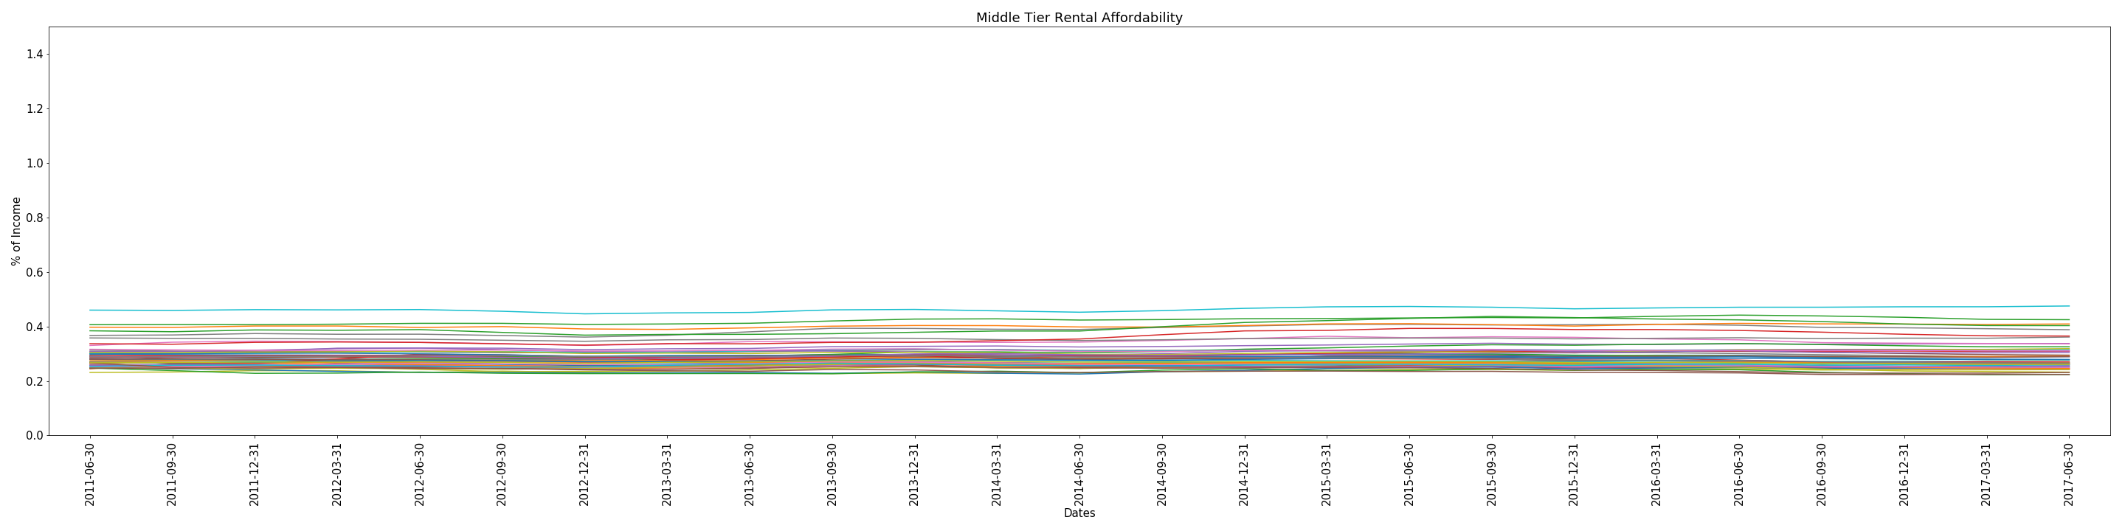
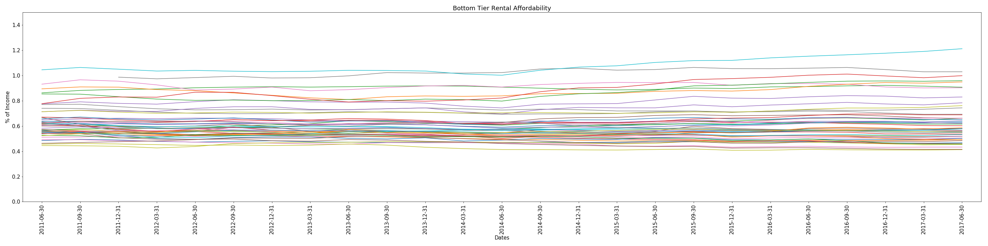
Rent Affordability

Slide 28
Post Mortem
04
Difficulties:
Broad Scope → Narrow Scope
50 Cities → 1 or 2 Cities
Plethora of Data and Data Sources
Narrow the source data
Additional Questions?
Specific Cities → Neighborhoods
Forecasting

Slide 29


Thank You
In Memory of Sam Schlunz

Slide 30
Questions?

